Slide 1
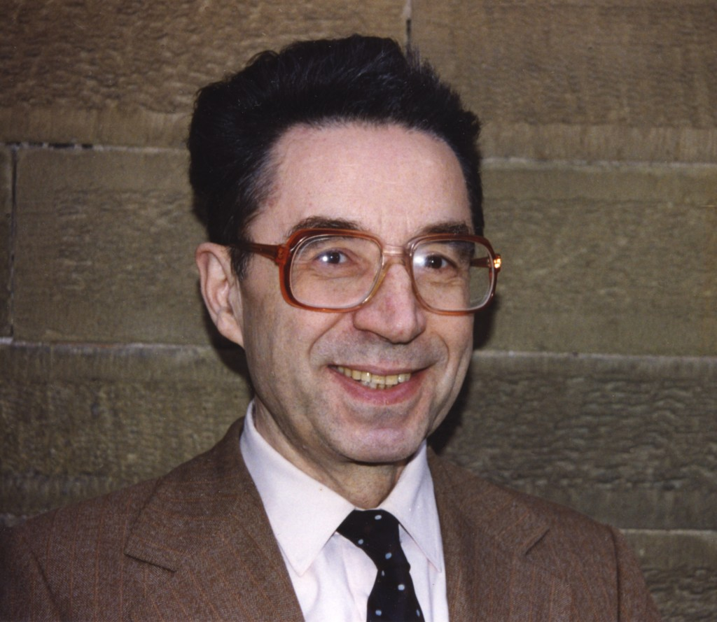
ЮРИЙ НИКОЛАЕВИЧ
ХОЛОПОВ
1932 - 2003

Slide 2
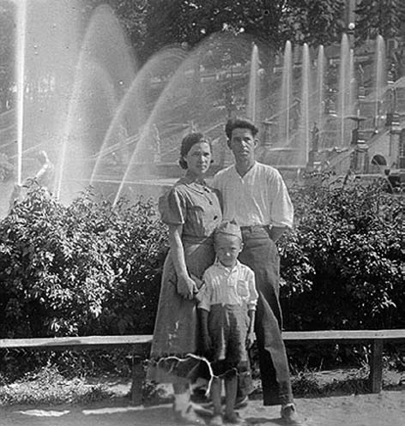
С родителями
Николаем Николаевичем
и Зинаидой Федоровной.
Петергофские фонтаны,
1938 год.

Slide 3
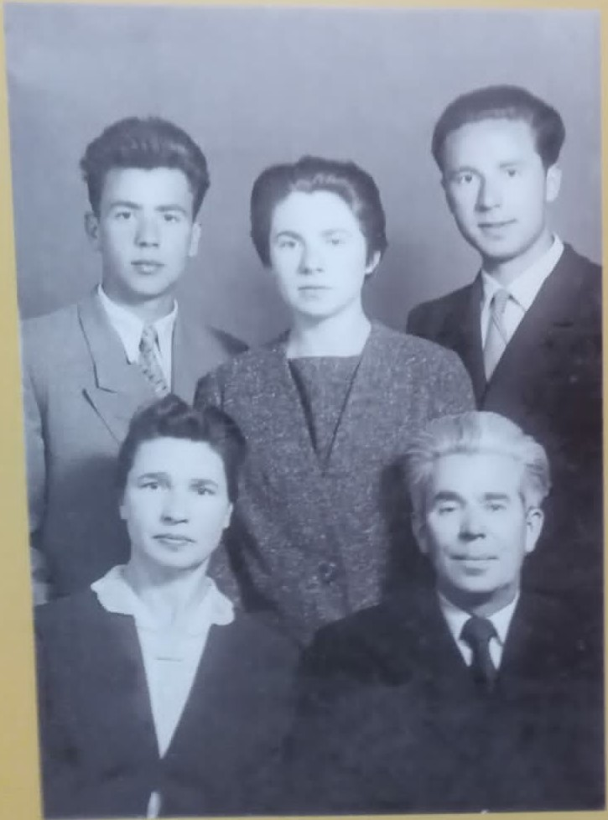
Семья Холоповых:
Отец – Николай Николаевич
Мать – Зинаида Федоровна
Справа – Юрий
В центре – сестра Валентина
Слева – брат Павел

Slide 4
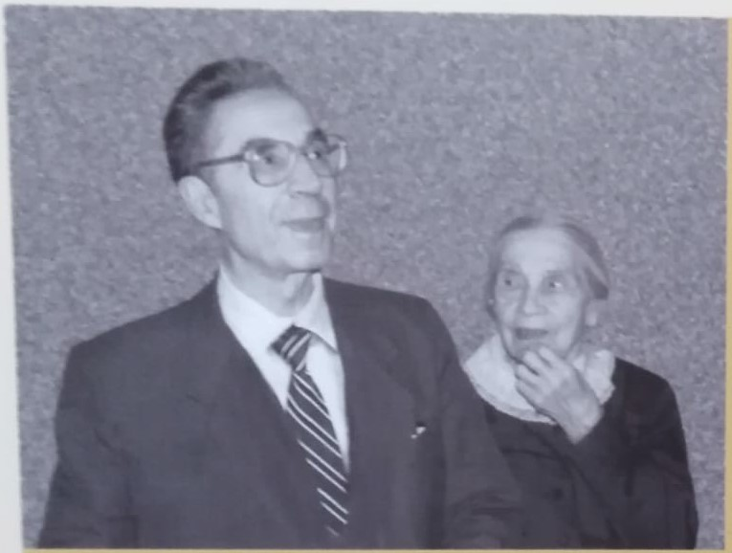
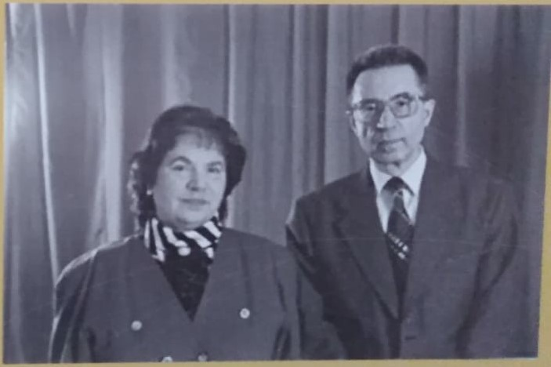
С сестрой, Валентиной Николаевной.
С мамой, Зинаидой Федоровной.

Slide 5
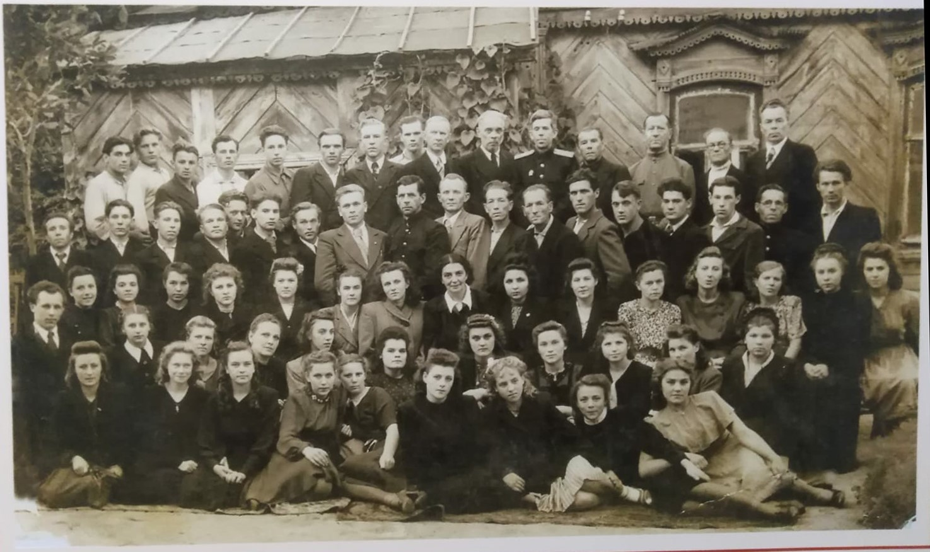
Рязанское музыкальное училище
1947 год.

Slide 6
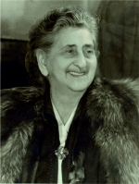
Екатерина Давыдовна
Аглинцева

Slide 7
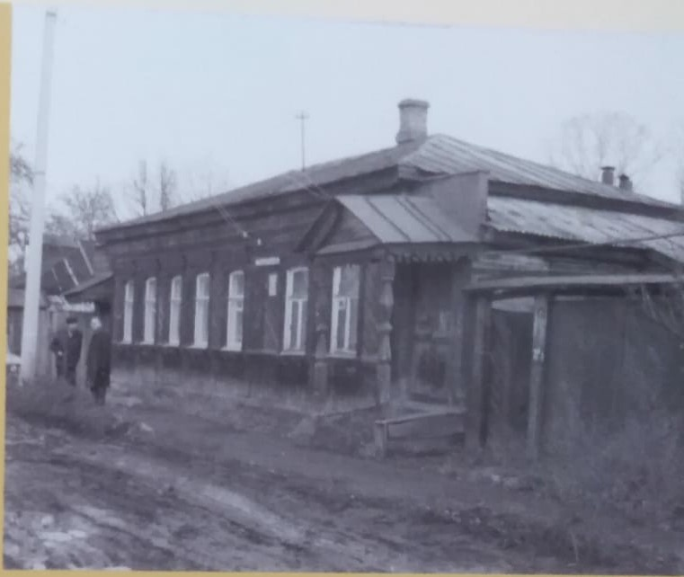
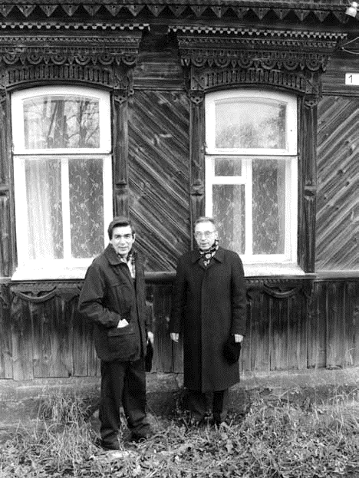
Рязань, 1-й проезд Гагарина, д. 3,
дом Лоскутовых, в котором семья Холоповых
в течение 30 лет жила впятером в 1 комнате.
У родительского дома Холоповых
с А. Бабием,
рязанским художником.

Slide 8
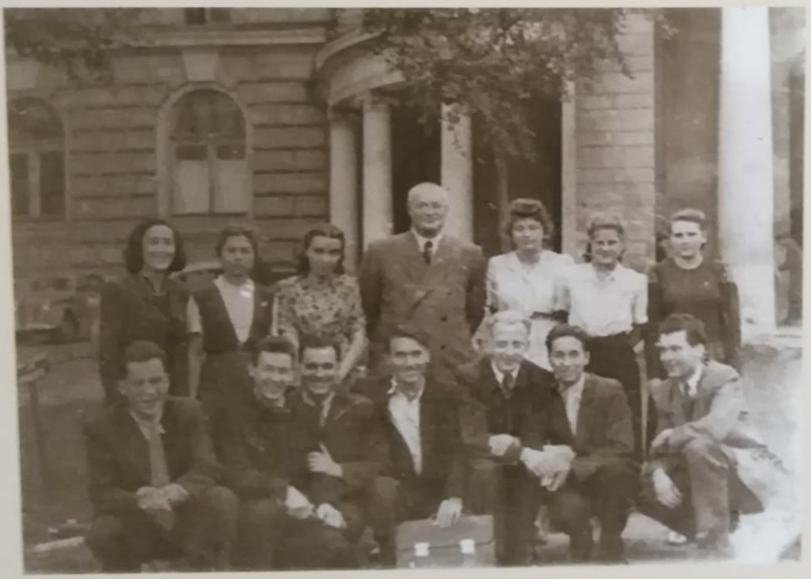
Студенты Московской
государственной
консерватории
с профессором И.В. Способиным.
1950 год.

Slide 9
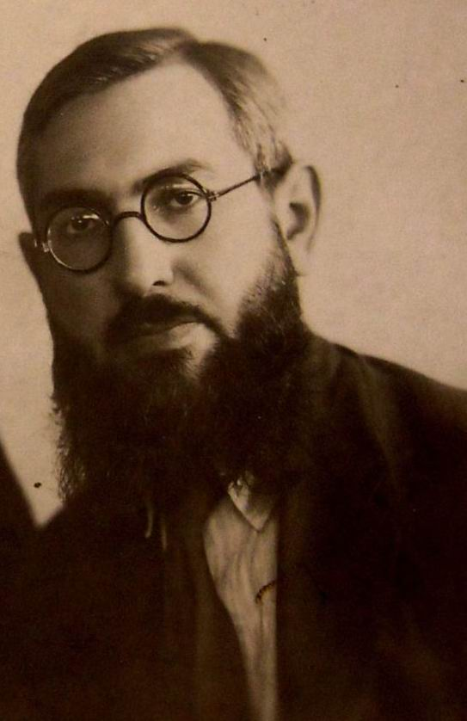
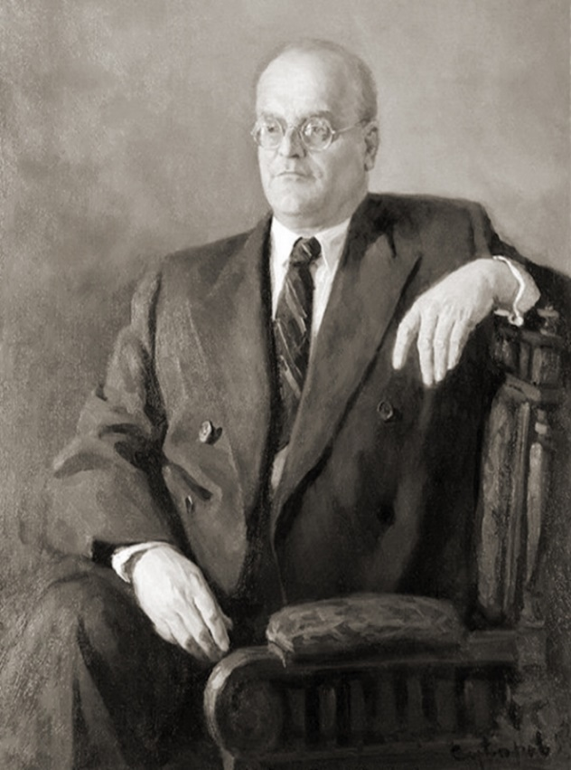
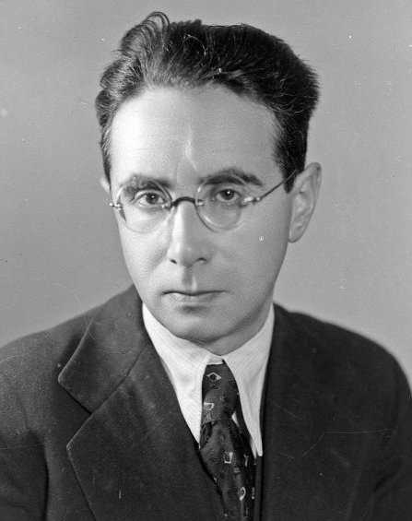
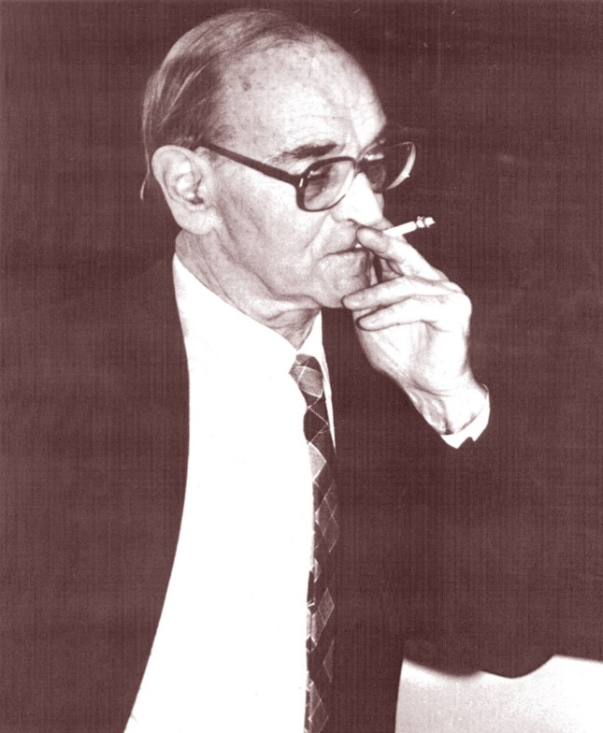
Игорь Владимирович
Способин
Виктор Абрамович
Цуккерман
Юрий Александрович
Фортунатов
Роман Ильич
Губер

Slide 10
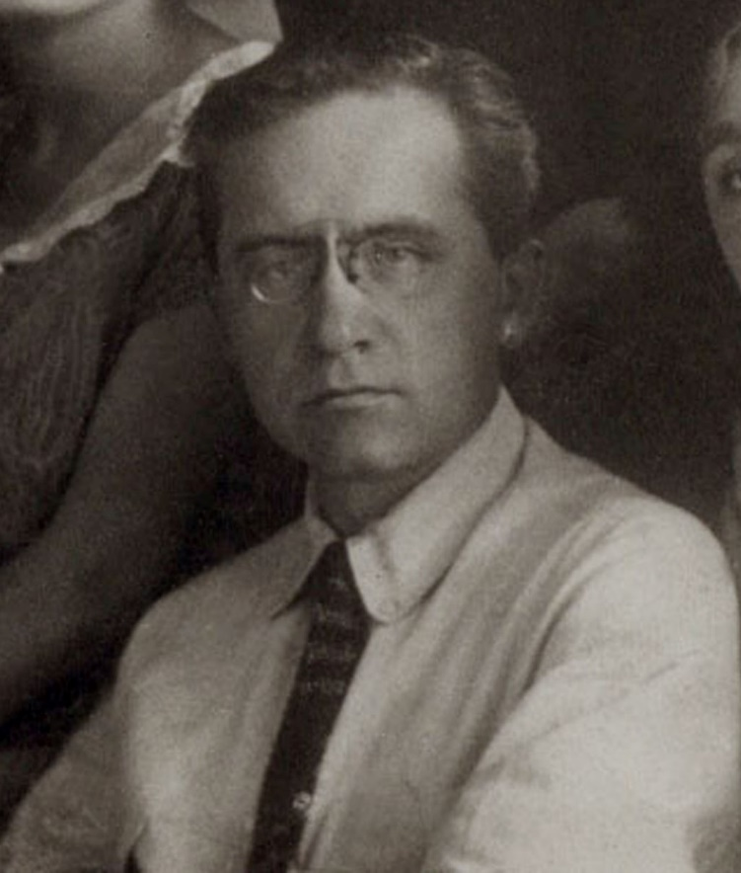
Семен Семенович
Богатырев

Slide 11
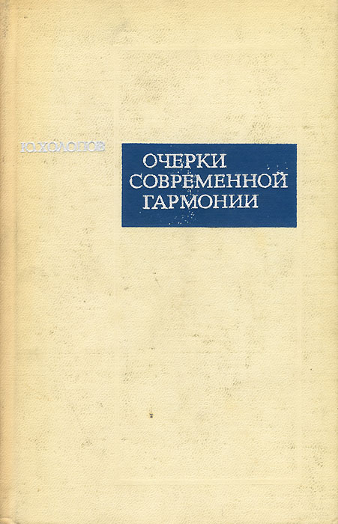

Slide 12
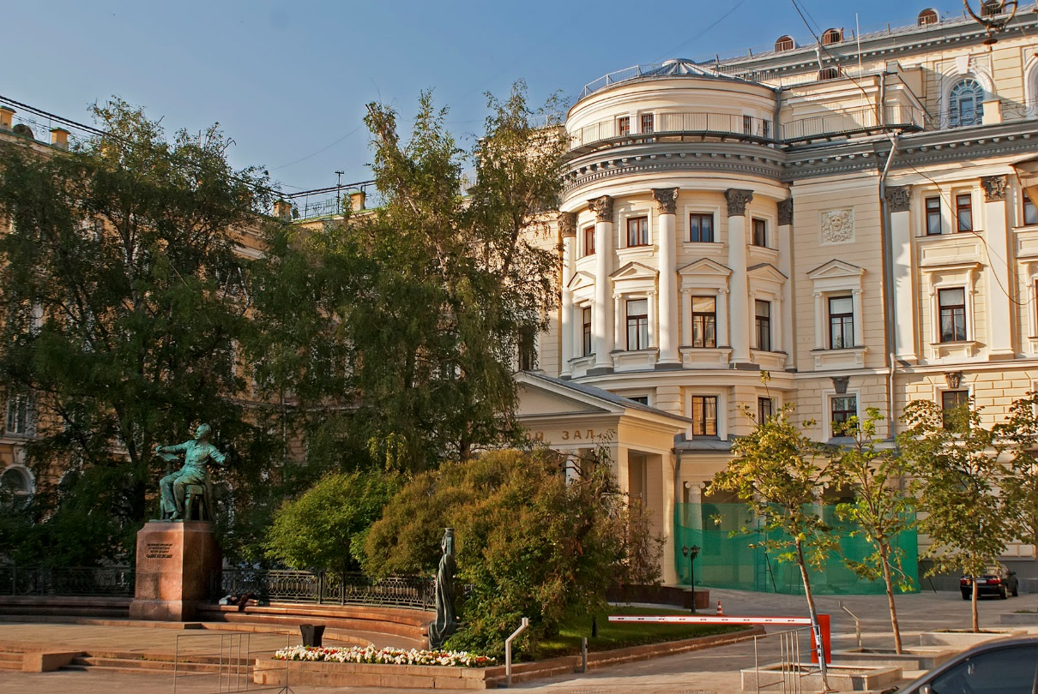
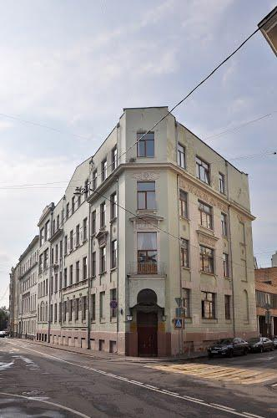
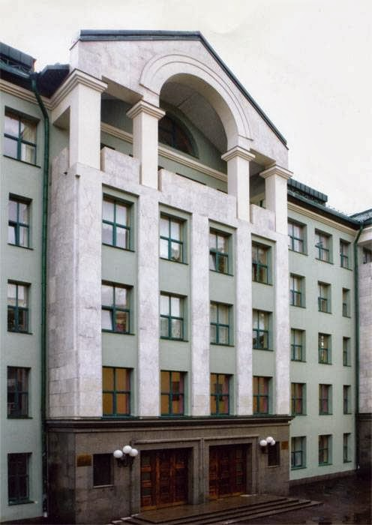
Московская консерватория
им. П.И. Чайковского
Училище при
Московской консерватории
Центральная музыкальная
школа при
Московской консерватории

Slide 13
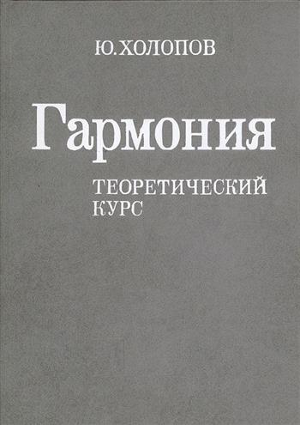
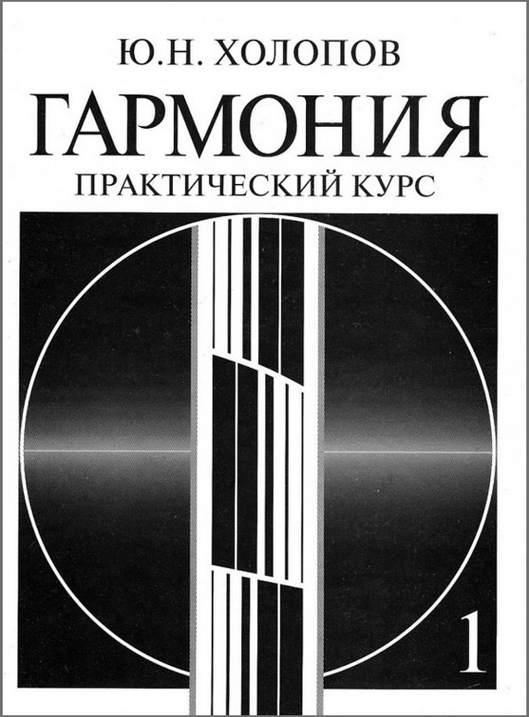
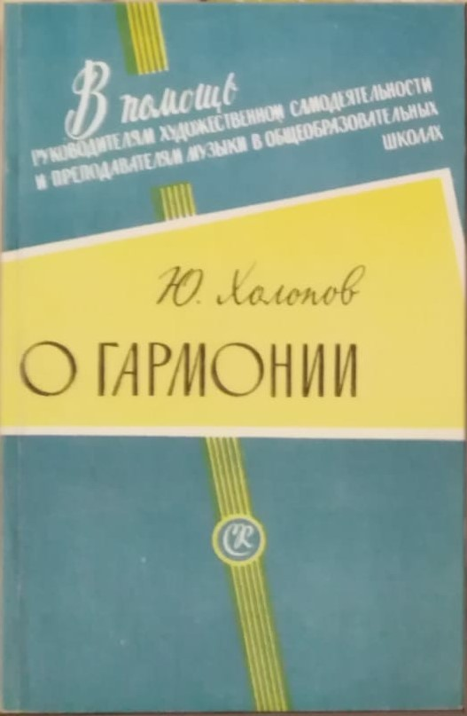
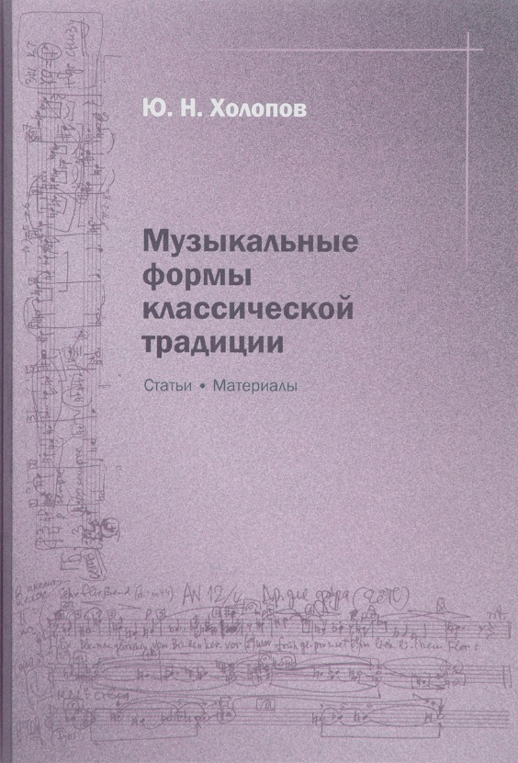
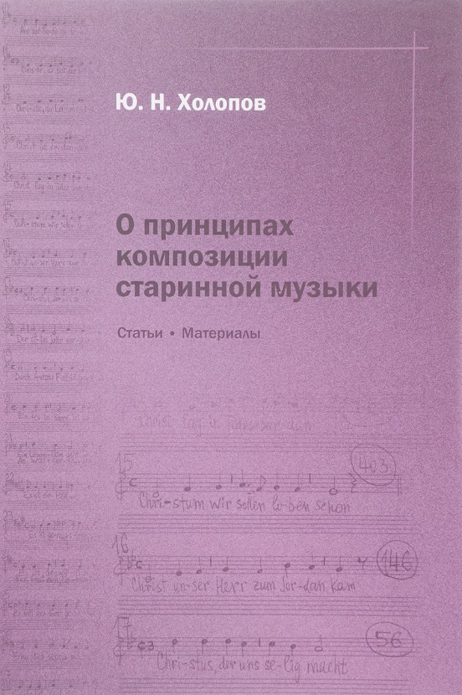

Slide 14
«Описательность – злейший враг анализа»
«Реприза в сонате пишется затем,
чтобы не повторять экспозицию»
«Основной тон – это корень аккорда»
«Читать – значит писать»
Ю.Н. Холопов

Slide 15
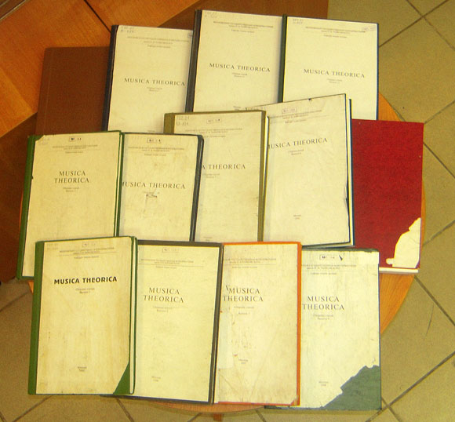

Slide 16
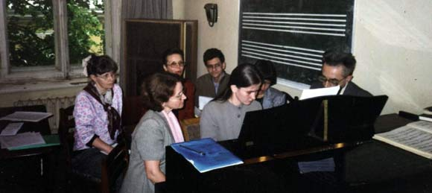
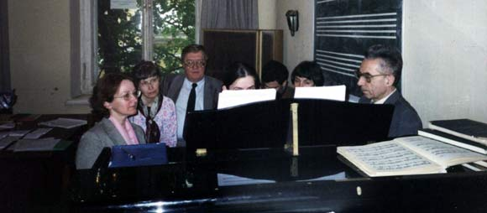
Экзамен по гармонии, июнь 2002 г.
Слева направо: Т. А. Старостина,
М. И. Катунян, Е. А. Николаева,
Г. И. Лыжов, М. Хорькова (студ.),
В. С. Ценова, Ю. Н. Холопов.
Экзамен по гармонии, июнь 2002 г.
Слева направо: М. И. Катунян,
Т. А. Старостина, И. К. Кузнецов,
М. Хорькова (студ.), Г. И. Лыжов,
В. С. Ценова, Ю. Н. Холопов.

Slide 17
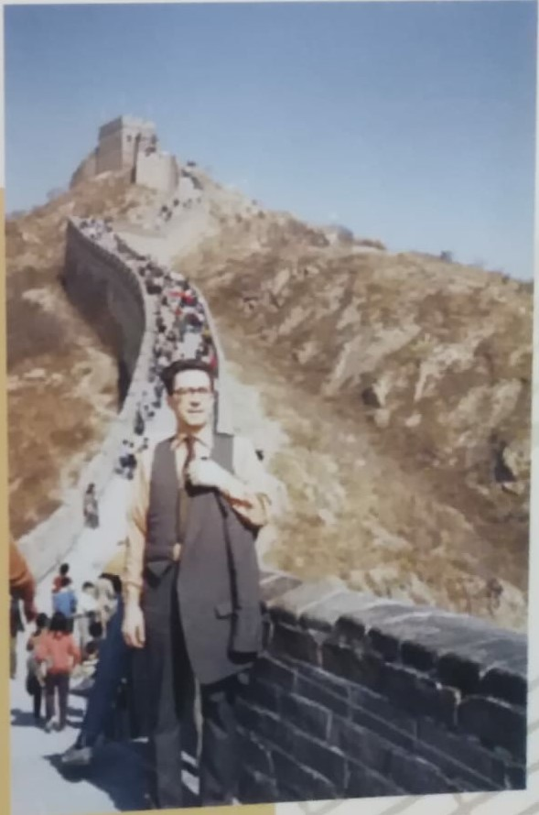
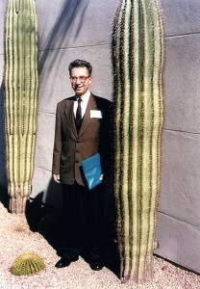
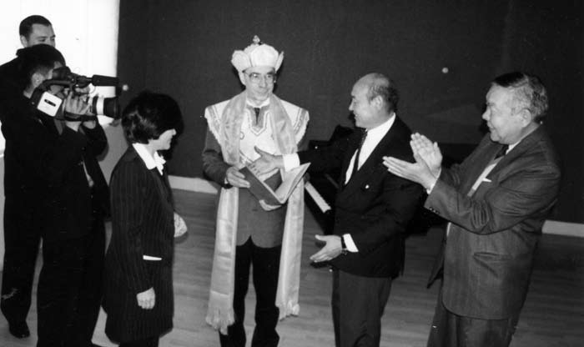
Монголия
Китай, Великая
Китайская стена
США, Феникс

Slide 18
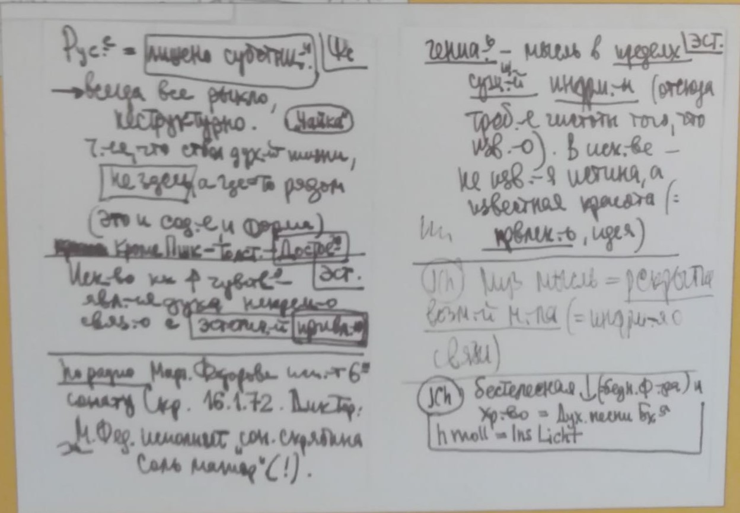
Фрагменты рукописи
Ю.Н. Холопова

Slide 19
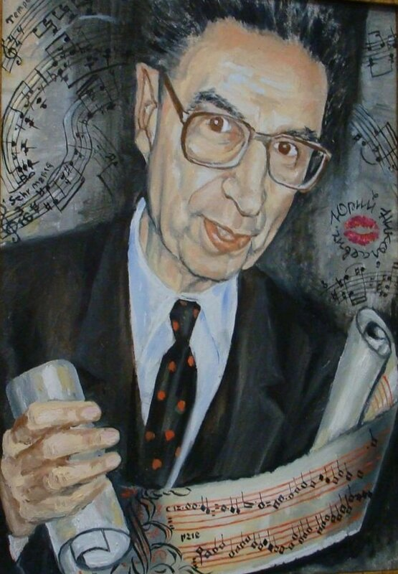
Портрет Юрия Николаевича Холопова
работы заведующей читальным залом
Библиотеки Московской консерватории
Наталии Николаевны Оленевой.

Slide 20
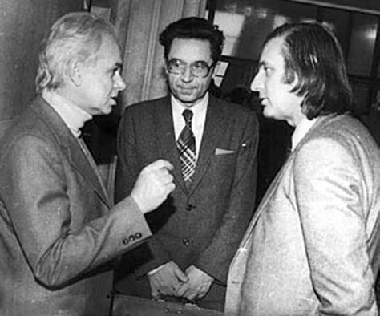
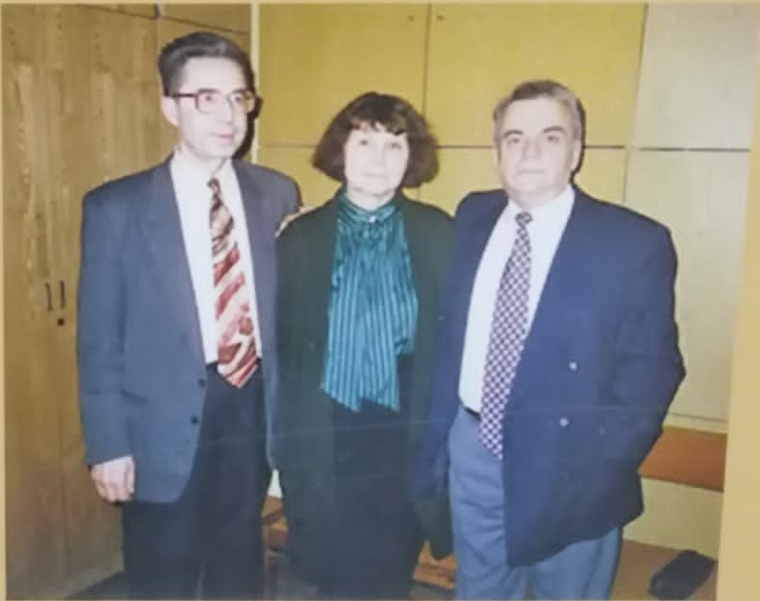
С Эдисоном Денисовым
и Альфредом Шнитке.
1984 год.
С Софией Губайдулиной
и Борисом Тевлиным.

Slide 21
ПЕРИОДИЗАЦИЯ ЭТАПОВ РАЗВИТИЯ ЕВРОПЕЙСКОЙ МУЗЫКИ
(ПО Ю.Н. ХОЛОПОВУ)
- начало XI века (реформа музыкальной нотации Гвидо Аретинского);
- начало XIV века (установление новой мензуральной ритмики, эпоха Ars nova);
- начало XVII века (Новое время, падение монодико-ладовой системы и наступление гомофонной эры);
- начало XX века (кризис романтической тональности и в целом — поиски нового музыкального языка).

Slide 22
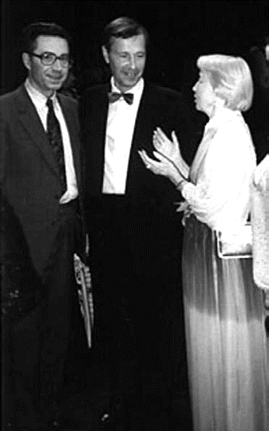
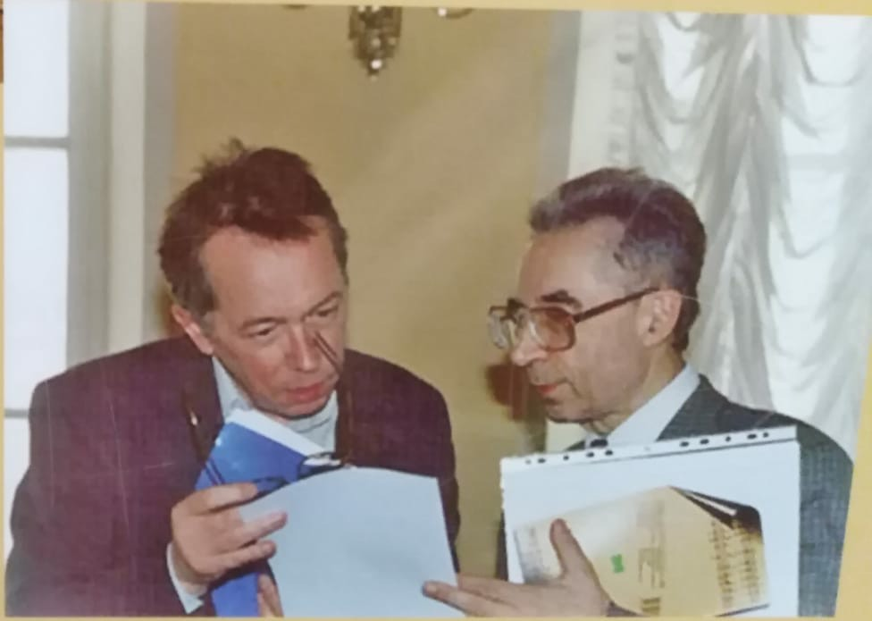
С сыном С.С. Прокофьева Олегом
и Галиной Сергеевной Улановой
в дни прокофьевского фестиваля в Германии.
1990 год.
С Эльмером Шенбергом.
Последняя фотография Юрия Николаевича Холопова.
19 апреля 2003 год.

Slide 23
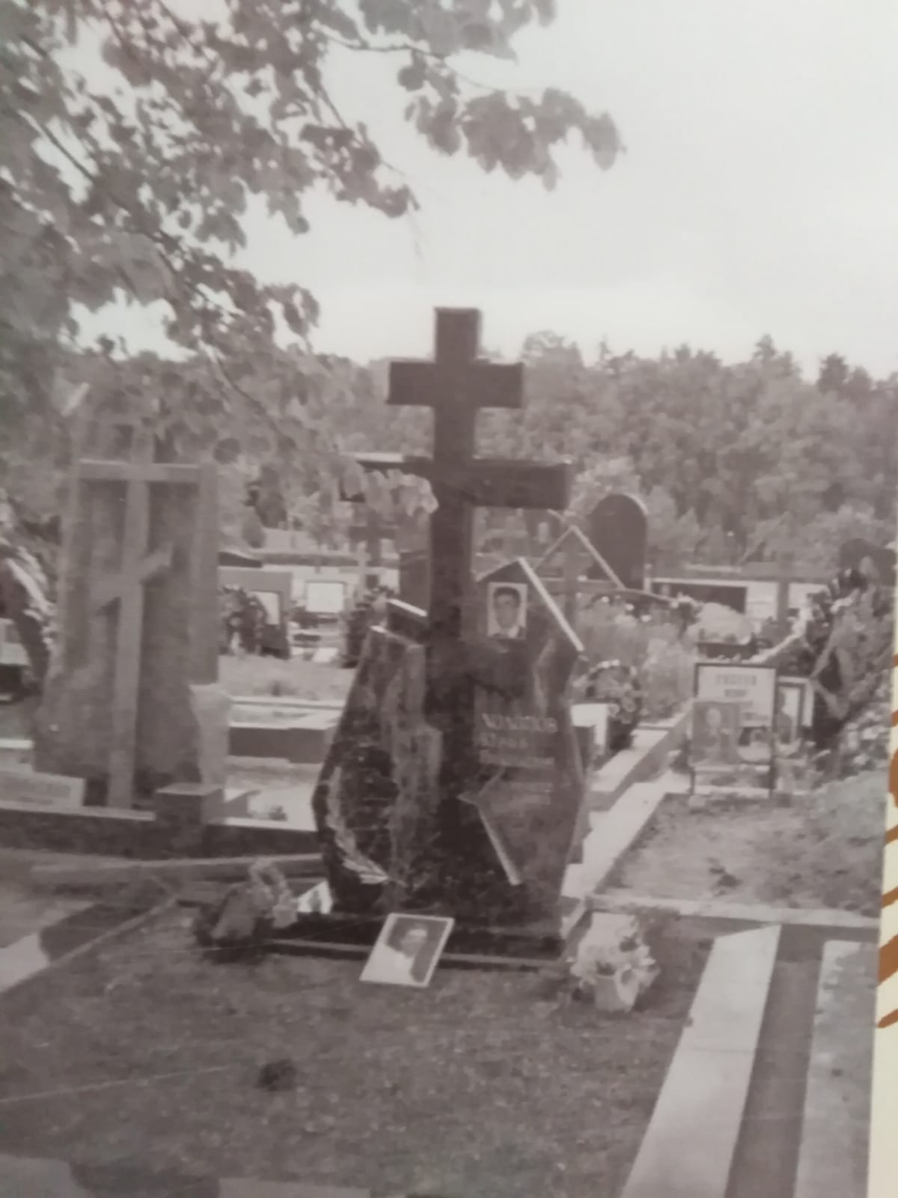
Москва.
Троекуровское кладбище.
Надгробие из камня-змеевика
изготовлено по проекту
Льва Львова из Рязани

Slide 24
Yuri Kholopov
Champion of Russia's 'lost' modernist composers
Gerard McBurney
Tue 3 Jun 2003 02.42 BST
Yuri Kholopov, who has died of cancer aged 70, was the most important and influential Russian music theorist and analytical scholar of modern times. The author of many textbooks, and more than a thousand papers, he was a key figure in the musical and intellectual life of his country.
For more than four decades, he taught energetically in the musicology department of the Moscow Conservatory - the composers who studied with him included Vassily Lobanov, Vladimir Tarnopolsky, Dmitri Smirnov and Elena Firsova. He also had a strong, if sometimes rebarbative, effect on the many fine performers who found themselves sitting through his fearsome introductory courses on harmony, form and other fundamental subjects.
His brilliant and highly unconventional Exercises In Harmony (1983) incorporated credited excerpts from students' classroom exercises to show the rich possibilities of unorthodox approaches to sometimes difficult problems. The culmination of his life's work came in his Harmonic Analysis (1996, 2001 and a third part yet to be published).
Kholopov lectured brilliantly on the classics and, like most theorists of his calibre, had much to say on Beethoven. However, his heart was in the 20th century, with particular reference to the kind of Russian and European modern music that was, for most of the Soviet phase of his career, regarded with suspicion by the authorities controlling the institutions in which he worked.
For example, he wrote a sharply observant little book, Anton Webern: His Life And Music (1973), and published and lectured on Alban Berg and Arnold Schoenberg. He was also fascinating on Stravinsky.
For young Russian musicians, Kholopov was a bridge to kinds of music that few others could even talk about, let alone with his intellectual authority. He could make the most far-reaching connections between the work of composers from utterly different cultures.
In the west, he was more familiar for his major role in the rediscovery and reinvention of the history of 20th century Russian music, as it emerged from under the permafrost of socialist realism. He was an early champion of the so-called "lost" Russian modernists of the early 20th century, such as Arthur Lourié and Alexander Mosolov, and he wrote with specially warm vigour about the prophetic, if somewhat recherché, musical language of Nikolai Roslavets.
He was close to, and wrote with passion about, the more recent modernist generation of Alfred Schnittke, Edison Denisov and Sofia Gubaidulina, and their successors. When Denisov died in 1996, Kholopov mourned him keenly, and devoted much energy thereafter to promoting the performance and study of his music.
In recent years, when Soviet music had begun to become a more respectable field of study in the west, Kholopov travelled to conferences in many countries, usually to set the record straight in some way. He was astute and fascinating, for example, on the internal logic of the works of Shostakovich, a composer whose growing popularity in the west has often been fuelled by reactions to the end of the cold war, but who Kholopov strongly felt was worthy of study in more rigorous, purely musical, ways.
Born in Ryazan, just over a hundred miles southeast of Moscow, Kholopov emerged from the city's musical preparatory college in 1949, graduated in music theory and composition at the Moscow Conservatory in 1954 and undertook postgraduate studies till 1960, when he started teaching there. His professorship came in 1983.
He was a reserved and formal man, fierce towards intellectual and musical slackness in both students and opponents. Music and its workings, his pupils and colleagues knew, were what mattered, and the broaching of other subjects would be greeted with little response. His cold stare, when he disapproved of something, cast a terror over many generations of students.
None the less, on the day before his death, having put classes ahead of chemotherapy, Kholopov was unusually amusing, and even told some jokes. His students were, in any case, used to eccentricities, such as his ability to sustain his lithe and wiry frame on chunks of stale bread, gnawed absent-mindedly on the run between library and classroom.
Like many intellectuals of his generation, Kholopov welcomed the rebirth of older kinds of Russianness with the fall of communism in the 1990s: in recent years, he became markedly interested in Russian Orthodox Christianity and - occasionally and rather alarmingly - in nationalist ideas of the integrity of the Russian tradition, to the exclusion of those composers not to be considered genuinely Russian. To the relief of many, in the last few years these stronger nationalist feelings seemed to have abated.
His wife, from whom he had been separated, predeceased him. He leaves a son.
Yuri Nikolaevich Kholopov, musical theorist and teacher, born August 14 1932; died April 24 2003

Slide 25
